Slide 1
...
...
...
...
...
...
...
...
..
...
...
...
...
...
...
...
...
...
...
...
...
...
...
...
...
...
...
...
...
...
...
...
...
...
...
...
TCP Implementation
...
...
...
...
...
...
...
...
...
...
...
...
...
...
...
...
...
...
...
...
...
...
...
...
...
...
...
...
...
...
...
...
...
...
...
...
Lecture 11 (Transport 2)
Notes:
Slides template credit: Josh Hug, Lisa Yan
today is the second half of the TCP implementation lecture and we're
0:45
going to take what we saw last time the ideas that we Ed to design reliability
0:50
and we're going to formalize them into an actual protocol
And if we have time we might also do some congestion control to get ahead on that

Slide 2
Implementing TCP: byte Notation (Segments, Sequence Numbers)
Implementing TCP
byte Notation (Segments, Sequence Numbers)
Maintaining State (Full Duplex, Connection Setup and Teardown)
Sliding Window
Header
Lecture 11, Spring 2026
Notes:
1:03
TCP and the first thing we'll do is we'll take the packet view of TCP and change it to a bite view

Slide 3
Notation Change: bytes vs. Packets
So far, we've used packets as the primary unit of data.
Each packet has a number.
Acks reference packet numbers.
Window size expressed in terms of number of packets.
TCP is implemented with bytes as the primary unit of data.
Each byte has a number. Packets are defined by the number of the first byte inside.
ACKs reference byte numbers.
Window size expressed in terms of number of bytes.
Lecture 10 designed reliability; Lecture 11 maps those ideas onto real TCP bytes, state, flags, and headers
Notes:
ecture 10 designed reliability; Lecture 11 maps those ideas onto real TCP bytes, state, flags, and headers

Slide 4
TCP Segments
TCP provides a reliable, in-order bytestream.
We have to split this bytestream into packets.
Sender Application
byte 1
byte 2
byte 3
byte 4
...
...
...
byte 79
byte 80
...
...
...
...
...
...
...
...
...
...
...
...
...
...
...
...
...
...
...
...
...
...
...
...
...
...
...
byte 1
byte 2
byte 3
byte 4
...
...
...
byte 79
byte 80
...
...
...
...
...
...
...
...
...
...
...
...
...
...
...
...
...
...
...
...
...
...
...
...
...
...
...
Recipient Application
Notes:
the B stream that we talked about and remember the bite stream is a sequence of bytes in order
3:33
infinite length the sender has a bite stream we feed it into a pipe and then the recipient receives those exact same
3:40
bytes in the same order reliably now the only difference between this picture and
3:46
the ones you've previously seen is that I have stamped numbers on every single
3:52
bite so now we have to connect this picture with the packet picture from last time and this is how we'll square
3:59
the two pictures together so the way that you build a packet as byes come in
4:05
and remember the sender application doesn't have to give you the entire infinite length by stream at once it
4:11
could feed you the bytes one by one for example if it's Computing data and it's sending out any results that it computes

Slide 5
TCP Segments
A segment is sent when the segment is full (max segment size),
or when the segment is not full, but times out waiting for more data.
Sender Application
byte 1
byte 2
byte 3
byte 4
...
...
...
byte 79
byte 80
...
...
...
...
...
...
...
...
...
...
...
...
...
...
...
...
...
...
...
...
...
...
...
...
...
...
...
TCP
HDR
TCP Segment
TCP header carries a sequence number indicating where in the bytestream this segment fits.
TCP
HDR
TCP Segment
byte 1
byte 2
byte 3
byte 4
...
...
...
byte 79
byte 80
...
...
...
...
...
...
...
...
...
...
...
...
...
...
...
...
...
...
...
...
...
...
...
...
...
...
...
Recipient Application

Slide 6
TCP Segments
TCP/IP packet: IP packet with TCP header and TCP data inside.
Size limits:
IP packet: Maximum transmission unit (MTU).
TCP segment: Maximum segment size (MSS).
MSS = MTU – (IP header) – (TCP header).
Limit MTU bytes
Limit MSS bytes
IP Header
TCP Header
TCP Payload (Segment)
IP Payload
Notes:
so packets larger than the MTU will get fragmented and we don't want that so we
6:53
will say the IP packet is limited to MTU bites and to figure out how big one of
6:59
these segments can be we just have to do some math this whole thing can be up to MTU bytes that's a limit that's set on
7:06
the Internet it's 1500 in real life but some of it's being used for the IP header so we have to subtract that off
7:13
and some of it's being used for the TCP header so we subtract that off and whatever is left that number is MSS that

Slide 7
TCP Sequence Numbers
Numbering starts at a randomly-generated Initial Sequence Number (ISN).
First byte is ISN+1, then ISN+2, etc.
Random ISNs reduce the risk that old duplicate segments will be mistaken for new data, and mitigate some spoofing attacks (for security).
ISN + 1
ISN + 2
ISN + 3
ISN + 4
...
...
...
ISN + 79
ISN + 80
...
...
...
...
...
...
...
...
...
...
...
...
...
...
...
...
...
...
...
...
...
...
...
...
...
...
...
Sender Application
ISN + 1
ISN + 2
ISN + 3
ISN + 4
...
...
...
ISN + 79
ISN + 80
...
...
...
...
...
...
...
...
...
...
...
...
...
...
...
...
...
...
...
...
...
...
...
...
...
...
...
Recipient Application
Notes:
here's one thing we haven't talked about that is important for security and that is the
7:56
fact that sequence numbers actually shouldn't start at zero if you want to know why the security course cs161 goes
8:02
into a lot more detail of why this is the case but just know for this class that there is a very important security
8:09
reason and for that reason we cannot start the counting at zero instead we
8:14
have to pick some random number and here we'll call it Isn initial sequence number and then just start at that
8:21
number and start counting up so if that number is 120 okay great then the first bite is 121 and then 122 and then 123
8:30
and then 124 and so on this doesn't really change anything we've talked about so far it's still a bite stream
8:37
and you're still counting the bytes all the way up the only difference is don't start counting from zero that's the only
8:44
difference and it doesn't change any of the other implementation details but

Slide 8
TCP Sequence Numbers
The sequence number of a segment is the number of the first byte in the segment.
Example: In the segment below, the sequence number is ISN + 140.
ISN + 1
ISN + 2
ISN + 3
ISN + 4
...
...
...
ISN + 79
ISN + 80
...
...
...
...
...
...
...
ISN+140
ISN+141
ISN+142
ISN+143
...
...
...
ISN+218
ISN+219
...
...
...
...
...
...
...
...
...
...
...
Sender Application
TCP
HDR
TCP Segment
TCP
HDR
TCP Segment
ISN + 1
ISN + 2
ISN + 3
ISN + 4
...
...
...
ISN + 79
ISN + 80
...
...
...
...
...
...
...
ISN+140
ISN+141
ISN+142
ISN+143
...
...
...
ISN+218
ISN+219
...
...
...
...
...
...
...
...
...
...
...
Recipient Application

Slide 9
TCP Ack Numbers
The ack number indicates the next expected byte (i.e. the first unreceived byte).
Example: All bytes up to (and including) ISN + 219 have been received, so the next unreceived byte is ISN + 220.
ISN + 1
ISN + 2
ISN + 3
ISN + 4
...
...
...
ISN + 79
ISN + 80
...
...
...
...
...
...
...
ISN+140
ISN+141
ISN+142
ISN+143
...
...
...
ISN+218
ISN+219
...
...
...
...
...
...
...
...
...
...
...
Sender Application
TCP
HDR
TCP Segment
Ack: ISN + 220.
TCP
HDR
TCP Segment
ISN + 1
ISN + 2
ISN + 3
ISN + 4
...
...
...
ISN + 79
ISN + 80
...
...
...
...
...
...
...
ISN+140
ISN+141
ISN+142
ISN+143
...
...
...
ISN+218
ISN+219
...
...
...
...
...
...
...
...
...
...
...
Recipient Application

Slide 10
TCP Sequence and Ack Numbers
The sequence number of a segment is the number of the first byte in the segment.
Sender sends a packet with sequence number j.
The packet contains B bytes.
bytes in the packet are numbered: j, j+1, j+2, j+3, ..., , j+B–1.
Recipient sends a cumulative ack (number of highest byte received, plus one).
If all prior data is received, ack number is j+B, the next expected byte, or the first unreceived byte.
If earlier data before this packet is missing, the ack number will be lower.

Slide 11
TCP Sequence and Ack Numbers
Assuming only one packet in flight, all packets length B, and no loss:
The last ack number is equal to the next sequence number.
Receiver ack: "I expect j + B next." → Sender: "I'm sending j + B."
seq = j
ack = j + B
seq = j + B
ack = j + 2B
seq = j + 2B
Sender
Recipient

Slide 12

Received ACK Scenario
Host B
Host A
1. Host B receives bytes 92-191 (100 Bytes), and expects next byte = 192
Seq=92, 100 bytes of data
timeout
ACK192
2. Host A sends bytes 192-291 (100 Bytes)
Seq=192, 100 bytes of data
2. Host B receives bytes 192-291 (100 Bytes), and expects next byte = 292
ACK=292
Notes:
HostB receives Seq# 192-291 (100 Bytes), and expects the next received Seq# to be 292

Slide 13
Premature Timeout
Host A
Host B
Note: Seq 92 and Seq 100 are sent back-to-back, even though figure shows a gap for clarity.
1. Host B receives bytes 92-99 (8 bytes), and expects next byte = 100
Seq=92, 8B data
timeout
Seq=100, 20B data
2. Host B receives bytes 100-119 (20 bytes), and expects next byte = 120
ACK=100
3. Host A times out and resends bytes 92-99 (8 bytes).
ACK=120
Seq=92, 8B data
4. Host B receives bytes 92-99 (8 bytes). But it has already received up to byte 119, so it sends cumulative
ACK for byte 120
ACK=120
Notes:
SendBase=100
HostB receives Seq# 100-119 (20 bytes), and expects the next received Seq# to be 120

Slide 14
Lost ACK Scenario
Host A
Host B
1. Host B receives bytes 92-99 (8 bytes), and expects next byte = 100
Seq=92, 8B data
timeout
ACK=100
X
2. Host A times out and resends bytes 92-99 (8 bytes).
Seq=92, 8B data
3. Host B receives bytes 92-99 (8 bytes), and expects next byte = 100
ACK=100

Slide 15
Lost ACK Scenario 2
Host A
Host B
1. Host B receives bytes 92-99 (8 bytes), and expects next byte = 100, but the ACK is lost
Seq=92, 8 bytes of data
Seq=100, 20 bytes of data
ACK=100
2. HostB receives Seq# 100-119 (20 bytes), and expects the next received Seq# to be 120
X
3. Host A receives ACK for byte 120. This cumulative ACK covers for the earlier lost ACK of byte 100, so Host A knows that Host B has received all bytes up to 119, so it can send the next bytes 120-134 (15 bytes)
ACK=120
Q: what happens if the segment with Seq=92, 8 bytes of data from Host A to Host B gets lost?
A: Host B will NOT send ACK=120, since a cumulative ACK=120 implies that all previous segments with Seq < 120 have been received. Host B will send ACK=92, assuming all all previous segments with Seq < 92 have been received.
Seq=120, 15 bytes of data
15
Notes:
1. Host B receives bytes 92-99 (8 bytes), and expects the next received Seq# to be 100, but the ACK is lost.
1. Host B receives bytes 92-99 (8 bytes), and expects next byte = 100

Slide 16
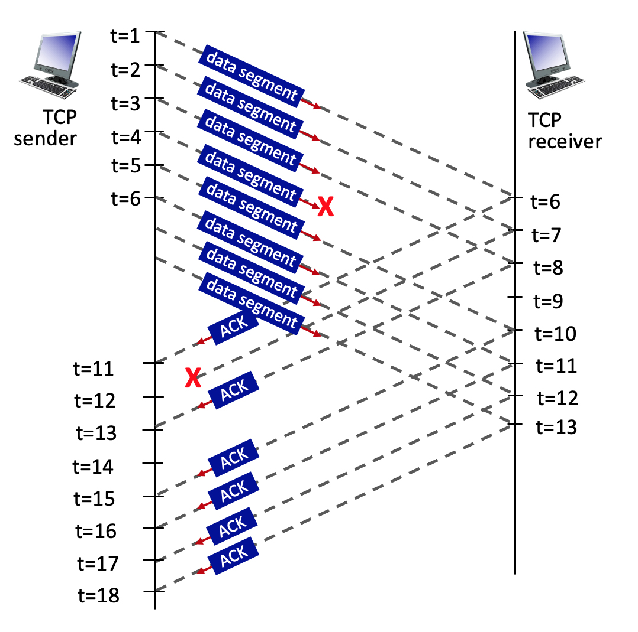
TCP Sequence and ACK Numbers
0
Consider the figure, where a TCP sender sends 8 TCP segments at t = 1, 2, 3, 4, 5, 6, 7, 8. Suppose the initial value of the sequence number is 0 and every segment sent to the receiver each contains 100 bytes. The delay between the sender and receiver is 5 time units, and so the first segment arrives at the receiver at t = 6. The ACKs sent by the receiver at t = 6, 7, 8, 10, 11, 12 are shown. The TCP segments (if any) sent by the sender at t = 11, 13, 15, 16, 17, 18 are not shown. The segment sent at t=4 is lost, as is the ACK segment sent at t=7.
Q: What is the sequence number of the segment sent at t=2?
ANS: 0+100=100.
Q: What is the ACK value carried in the receiver-to-sender ACK sent at t = 6?
ANS: 0+100=100. By sending this ACK, the receiver is telling the sender: "I've received everything up to byte 99, and I'm now expecting byte 100.“
Q: What is the ACK value carried in the receiver-to-sender ACK sent at t = 8?
ANS: 300. By sending this ACK, the receiver is telling the sender: "I have received everything up to byte 299. Please send me the next byte, which should be 300.“
Q: What is the ACK value carried in the receiver-to-sender ACK sent at t = 10?
A: 300. By sending this ACK, the receiver is telling the sender: "I have received everything up to byte 299. Please send me the next byte, which should be 300.“ (Even though the receiver has received segments sent after the lost one, it cannot acknowledge them yet due to cumulative ack mechanism)
100
200
300
400
500
Ack 100
Ack 200
Ack 300
Ack 300
Ack 300
Ack 300
Ack 300
16
Notes:
TCP uses sequence numbers to keep track of the bytes sent in a data stream. Each byte of data is assigned a unique sequence number.
## Given Information
- Initial sequence number: 0
- Each segment contains 100 bytes
- Segments are sent at t = 1, 2, 3, 4, 5, 6, 7, 8
## Calculating the Sequence Number
To find the sequence number of the segment sent at t=2, we need to consider the following:
1. The initial sequence number is 0 for the first segment (t=1).
2. Each segment contains 100 bytes.
3. The sequence number for each subsequent segment increases by the number of bytes in the previous segment.
Therefore:
- Segment at t=1: Sequence number = 0
- Segment at t=2: Sequence number = 0 + 100 = 100
## Explanation
The sequence number for the segment sent at t=2 is 100. This is because:
1. The first segment (t=1) starts with sequence number 0.
2. Each segment contains 100 bytes of data.
3. The second segment (t=2) will have a sequence number that is the sum of the initial sequence number (0) and the number of bytes in the first segment (100).
This pattern would continue for subsequent segments:
- Segment at t=3: Sequence number = 100 + 100 = 200
- Segment at t=4: Sequence number = 200 + 100 = 300
And so on.
It's important to note that the lost segment at t=4 and the lost ACK at t=7 do not affect the sequence numbers of the segments being sent. They would, however, impact the retransmission and acknowledgment process in a real TCP connection.

Slide 17
TCP sequence and ACK numbers Explanations
TCP uses sequence numbers to keep track of the bytes sent in a data stream. Each byte of data is assigned a unique sequence number.
Given Information: Initial sequence number: 0 - Each segment contains 100 bytes. Segments are sent at t = 1, 2, 3, 4, 5, 6, 7, 8.
To find the sequence number of the segment sent at t=2, consider the following:
1. The initial sequence number is 0 for the first segment (t=1).
2. Each segment contains 100 bytes.
3. The sequence number for each subsequent segment increases by the number of bytes in the previous segment.
1. The first segment (t=1) starts with sequence number 0. 2. Each segment contains 100 bytes of data. 3. The second segment (t=2) will have a sequence number that is the sum of the initial sequence number (0) and the number of bytes in the first segment (100).
Segment at t=1: Sequence number = 0
Segment at t=2: Sequence number = 0 + 100 = 100
Segment at t=3: Sequence number = 100 + 100 = 200
Segment at t=4: Sequence number = 200 + 100 = 300
The lost segment at t=4 and the lost ACK at t=7 do not affect the sequence numbers of the segments being sent. They would, however, impact the retransmission and acknowledgment process in a real TCP connection.
Notes:
The sequence number for the segment sent at t=2 is 100. This is because:
, Calculate the Sequence Number

Slide 18
TCP sequence and ACK numbers Explanations
Given: The initial sequence number is 0. 8 TCP segments are sent at t = 1, 2, 3, 4, 5, 6, 7, 8. Each segment contains 100 bytes. The delay between sender and receiver is 5 time units. The segment sent at t=4 is lost. We need to determine the ACK value sent by the receiver at t = 6.
Segments Received: At t = 6, only the first segment (sent at t = 1) has arrived at the receiver due to the 5-unit delay.
bytes Received: The first segment contains 100 bytes.
ACK Mechanism: TCP uses cumulative ACKs, which means it acknowledges all bytes up to the last contiguously received byte.
ACK Value Calculation: Initial sequence number: 0; bytes successfully received: 0-99 (100 bytes); Next expected byte: 0 + 100 = 100
Therefore, the ACK value carried in the receiver-to-sender ACK sent at t = 6 is 100, which indicates that the receiver has successfully received all bytes up to, but not including, byte 100. It's essentially saying, "I've received everything up to byte 99, and I'm now expecting byte 100."
Even though more segments were sent by the sender, due to the network delay, only the first segment has reached the receiver at t = 6. The lost segment at t = 4 doesn't affect this initial ACK because it hasn't even reached the receiver yet.
Notes:
This ACK value makes sense because:
1. Only one segment has been received (the one sent at t = 1).
2. Each segment contains 100 bytes.
3. The receiver is acknowledging the receipt of the first segment and indicating it's ready for the next byte.
The sequence number for the segment sent at t=2 is 100. This is because:
, Calculate the Sequence Number

Slide 19
Maintaining State (Full Duplex)
Implementing TCP
byte Notation (Segments, Sequence Numbers)
Maintaining State (Full Duplex, Connection Setup and Teardown)
Sliding Window
Header
Lecture 11, Spring 2026

Slide 20
TCP State
Reliability requires maintaining state at the end hosts.
Sender has to remember:
Which packets have been sent and not acked?
How much longer on the timer before I resend a packet?
Receiver has to buffer the out-of-order packets.
State is maintained at the end hosts, not in the network.
In each separate connection, both end hosts need to maintain state.

Slide 21
TCP is Full-Duplex
TCP connections are full-duplex.
Both hosts can send and receive data simultaneously in the same connection.
Two independent sequence-number spaces: One for A→B bytes, and one for B→A bytes.
Each packet carries both data and ack information.
"Here are some bytes starting at 15..."
"...Also, I ack receiving all your bytes up to (not including) 84."
15 | 16 | 17 | 18 | 19 | 20 | 21
H | e | l | l | o | , | B
77 | 78 | 79 | 80 | 81 | 82 | 83
H | e | l | l | o | , | A
A to B bytestream
B to A bytestream
Notes:
To support full-duplex connections:

Slide 22
TCP Connection Setup: Three-Way Handshake
Goal: Each host tells its ISN to the other host.
SYN. Client says: "My ISN is x."
SYN-ACK. Server says: "I received x (expecting x+1 next). Also, my ISN is y."
ACK. Client says: "I received y (expecting y+1 next)."
After the three-way handshake, both sides can start sending data.
SYN. seq=x
SYN-ACK. seq=y, ack=x+1
ACK. ack=y+1
Client
Server

Slide 23
TCP Connection Teardown
Normal termination with FIN:
Each side sends a FIN packet to say: "I'm done sending, but will keep receiving."
FIN packets are acked like any other data.
When only one side has sent FIN, the connection is half-closed.
When both sides have sent FIN (both done sending), the connection is closed.
Abrupt termination with RST:
Send a RST (reset) to say: "I will no longer send or receive data."
RST packets do not need to be acked.
Any data in flight is lost.
If the RST sender receives more data later, send another RST.
FIN
RST
ACK
FIN
data
ACK
RST
Client
Server
Client
Server

Slide 24
TCP Setup/Teardown Transition Diagram
CLOSED
Active open/SYN
Passive open
Close
Close
LISTEN
SYN/SYN+ACK
Send/SYN
SYN_RCVD
SYN/SYN+ACK
SYN_SENT
ACK
SYN+ACK/ACK
The ESTABLISHED state is where data are sent and acked.
Close/FIN
ESTABLISHED
Close/FIN
FIN/ACK
CLOSE_WAIT
FIN_WAIT_1
ACK
FIN/ACK
Close/FIN
FIN_WAIT_2
ACK + FIN/ACK
CLOSING
Timeout after 2 segment lifetimes
LAST_ACK
ACK
ACK
FIN/ACK
TIME_WAIT
CLOSED

Slide 25
TCP Setup/Teardown Transition Diagram (Simplified)
CLOSED
Wait a while
Send SYN
TIME_WAIT
SYN_SENT
Setup
Receive FIN
Send ACK
Receive SYN+ACK
Send ACK
The ESTABLISHED state is where data are sent and acked.
FIN_WAIT2
ESTABLISHED
Teardown
Receive ACK
FIN_WAIT1
Send FIN

Slide 26
Piggybacking
With full-duplex, if we get a packet but have no data to send, we have two choices:
Send the ack, with no data.
Piggybacking: Wait for some data, and send the ack with the data.
Piggybacking can be tricky because TCP is in the OS, separate from the application.
OS doesn't know when application will have more data.
Application isn't thinking about packets and acks.
SYN-ACKs are always piggybacked.
Ack and initial sequence number are sent together.
Not tricky, because OS is doing the handshake, not the application.

Slide 27
Sliding Window
Implementing TCP
byte Notation (Segments, Sequence Numbers)
Maintaining State (Full Duplex, Connection Setup and Teardown)
Sliding Window
Header
Lecture 11, Spring 2026

Slide 28
TCP Sliding Window
When we measured in packets, W was the maximum number of packets in flight.
When we measure in bytes, W is the maximum number of contiguous bytes in flight.
The window is a range of W contiguous bytes, starting at the first unacked byte.
Only these W bytes are allowed to be in flight.
The window slides right if and only if its leftmost bytes are acked.
Example: When 15–18 arrive, we can send 27–30.
First unacked byte
1
2
3
4
5
6
7
8
9
10
11
12
13
14
15
16
17
18
19
20
21
22
23
24
25
26
27
28
29
30
31
32
33
34
35
36
37
38
39
40
...
...
...
Window
W bytes
Sent and acked
Not sent yet

Slide 29
TCP Sliding Window
When we measured in packets, W was the maximum number of packets in flight.
When we measure in bytes, W is the maximum number of contiguous bytes in flight.
The window is a range of W contiguous bytes, starting at the first unacked byte.
Only these W bytes are allowed to be in flight.
The window slides right if and only if its leftmost bytes are acked.
Example: When 15–18 arrive, we can send 27–30.
First unacked byte
1
2
3
4
5
6
7
8
9
10
11
12
13
14
15
16
17
18
19
20
21
22
23
24
25
26
27
28
29
30
31
32
33
34
35
36
37
38
39
40
...
...
...
Window
W bytes
Sent and acked
Not sent yet

Slide 30
TCP Sliding Window
When we measured in packets, W was the maximum number of packets in flight.
When we measure in bytes, W is the maximum number of contiguous bytes in flight.
The window is a range of W contiguous bytes, starting at the first unacked byte.
Only these W bytes are allowed to be in flight.
The window slides right if and only if its leftmost bytes are acked.
Acking non-leftmost bytes in the window (e.g. 19–22) does not slide the window.
The window is determined by the first unacked byte (e.g. still 15).
First unacked byte
1
2
3
4
5
6
7
8
9
10
11
12
13
14
15
16
17
18
19
20
21
22
23
24
25
26
27
28
29
30
31
32
33
34
35
36
37
38
39
40
...
...
...
Window
W bytes
Sent and acked
Not sent yet

Slide 31
TCP Sliding Window
TCP uses cumulative acks and a sliding window.
Cumulative ack: "I have received everything up to (not including) 15."
Thus, first unacked byte is 15, and the sliding window is [15, 15 + W).
W is set as the minimum of two values:
Advertised window (recipient reports their remaining buffer space).
Congestion window (sender magically finds value to avoid network overload).
First unacked byte
1
2
3
4
5
6
7
8
9
10
11
12
13
14
15
16
17
18
19
20
21
22
23
24
25
26
27
28
29
30
31
32
33
34
35
36
37
38
39
40
...
...
...
Window
W bytes
Sent and acked
Not sent yet

Slide 32
Detecting Loss
Two ways to detect loss and resend. We resend if either condition is true.
In both cases, we always resend the first unacked packet (leftmost part of window).
Ack-based: If 3 duplicate acks are received, resend.
Receiving three copies of the same cumulative ACK signals that a later segment arrived but an earlier one is missing, so the sender immediately retransmits the first unacknowledged segment (leftmost byte of the window) without waiting for the timer.
Timer-based: Keep a single timer. If the timer expires, resend.
Set timer by estimating RTT (e.g. measure times between packets and acks, and take a moving average).
Resend 15–18 if timer expires, or if 3 copies of ack(15) received.
1
2
3
4
5
6
7
8
9
10
11
12
13
14
15
16
17
18
19
20
21
22
23
24
25
26
27
28
29
30
31
32
33
34
35
36
37
38
39
40
...
...
...
Window
W bytes
Sent and acked
Not sent yet
Notes:
uses two loss-detection triggers: timer expiration and three duplicate ACKs. Receiving three copies of the same cumulative ACK signals that a later segment arrived but an earlier one is missing, so the sender immediately retransmits the first unacknowledged segment (leftmost byte of the window) without waiting for the timer.

Slide 33
TCP Header
Implementing TCP
byte Notation (Segments, Sequence Numbers)
Maintaining State (Full Duplex, Connection Setup and Teardown)
Sliding Window
Header
Lecture 11, Spring 2026

Slide 34
TCP Header
What functions does TCP implement?
Demultiplexing (ports)
Reliability (checksum, sequence and ack numbers)
Connection setup and teardown (flags)
Flow control (advertised window)
Source Port (16) |  |  |  | Destination Port (16)
Sequence Number (32)
Acknowledgment Number (32)
Hdr Len (4) | 0000 | Flags (8) |  | Advertised Window (16)
Checksum (16) |  |  |  | Urgent Pointer (16)
Options (variable-length)
Payload

Slide 35
TCP Header
There are 8 flags that can be set in TCP. We care about 4 of them:
SYN: I'm sending my initial sequence number.
ACK: I'm acking data (please look at the ack number).
FIN: I'm done sending data, but will keep receiving data.
RST: I'm done sending and receiving data.
We won't look at the other four: CWR, ECE, URG, PSH.
Source Port (16) |  |  |  | Destination Port (16)
Sequence Number (32)
Acknowledgment Number (32)
Hdr Len (4) | 0000 | Flags (8) |  | Advertised Window (16)
Checksum (16) |  |  |  | Urgent Pointer (16)
Options (variable-length)
Payload

Slide 36
TCP Header
Remaining fields:
Header length: Measured in 4-byte words.
If no options, this is 5 (header is 20 bytes long).
0000: Reserved bits (always set to 0).
Urgent pointer: Used with the URG flag to indicate urgent data. Won't discuss.
Options: Extra functionality.
Example: SACK uses the options field to implement full-information acks.
Source Port (16) |  |  |  | Destination Port (16)
Sequence Number (32)
Acknowledgment Number (32)
Hdr Len (4) | 0000 | Flags (8) |  | Advertised Window (16)
Checksum (16) |  |  |  | Urgent Pointer (16)
Options (variable-length)
Payload

Slide 37
TCP: Summary
An elegant (though not perfect) piece of engineering that has stood the test of time.
Thought experiment: Will TCP continue to be a good solution?
Plenty of evolution in individual pieces:
Congestion control was added after-the-fact.
Better acknowledgments, ISN selection, timer estimation, etc.
But the core architectural decisions and abstractions remain:
bytestreams, connection-oriented, windows, etc.

